Slide 1
The 2019 HIARC Field Day Co-site Interference Filters
By
Ken N8KH

Slide 2
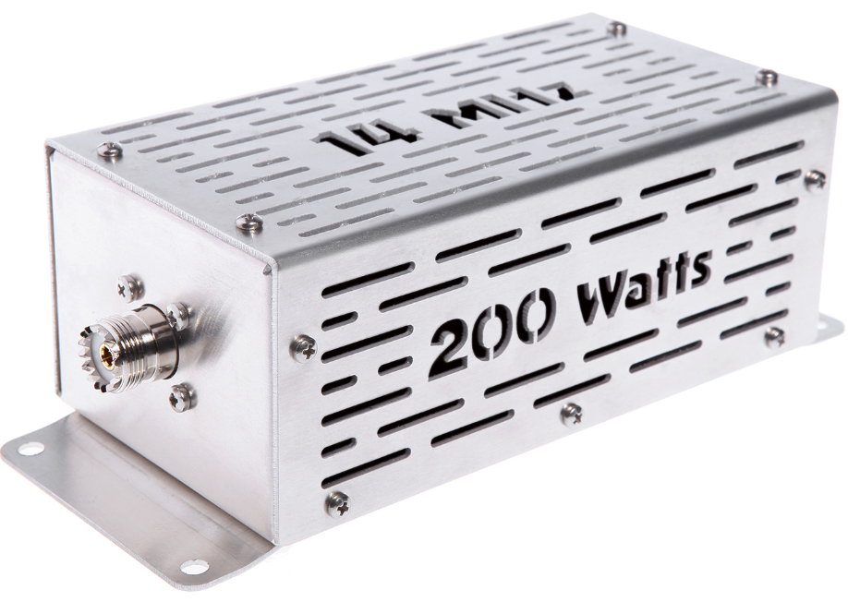

Slide 3
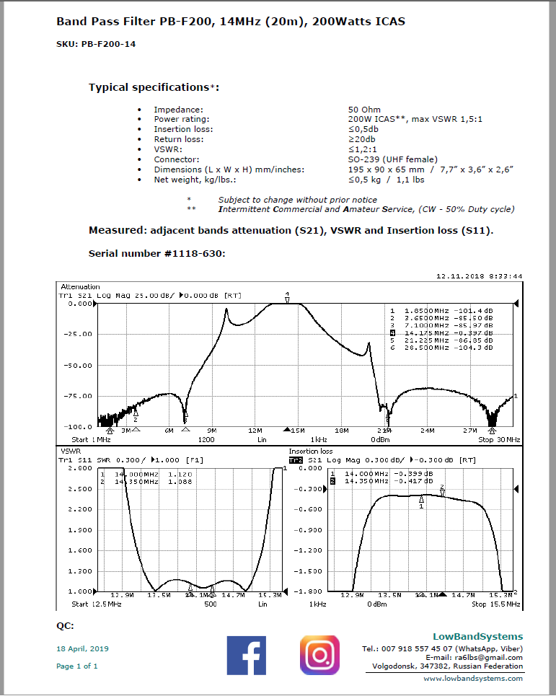

Slide 4
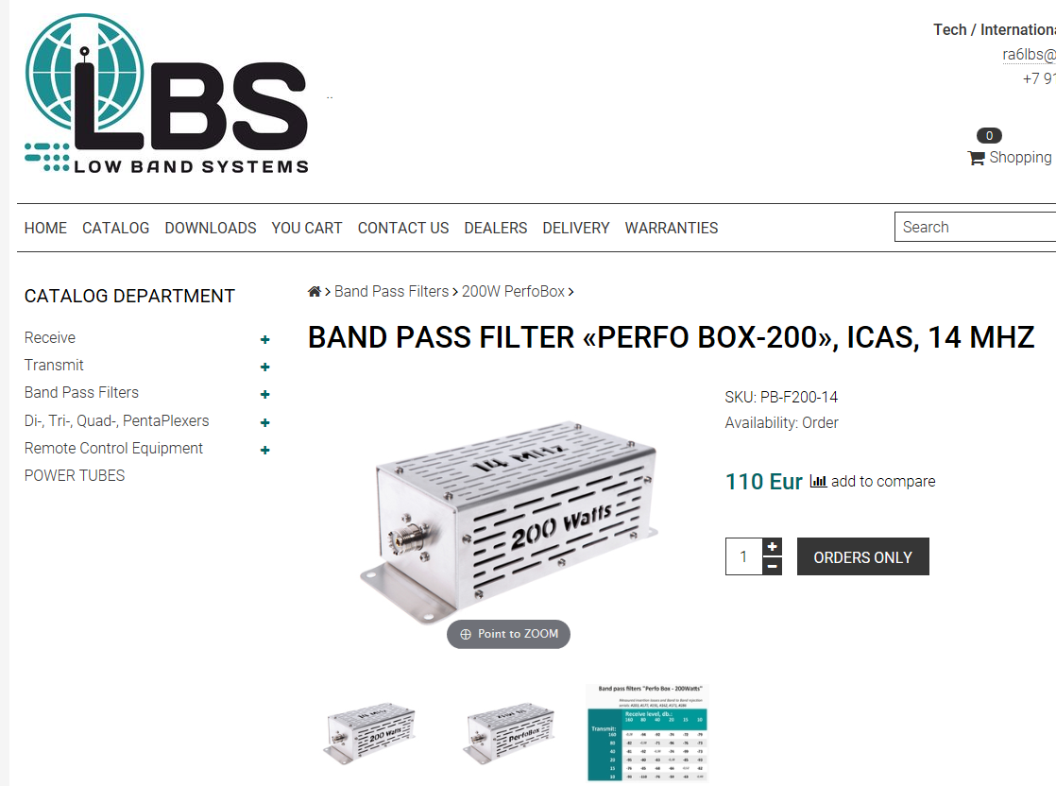
http://lowbandsystems.com/
[‎6/‎10/‎2019 5:51 PM] Hendrickson, Ken (US):
https://www.dxengineering.com/search/part-type/transmit-band-pass-filters/product-line/low-band-systems-hf-transmit-band-pass-filters?autoview=SKU&sortby=BestKeywordMatch&sortorder=Ascending&N=power-handling%3A200-w%2Bfrequency-range%3A3-5-4-0-mhz_7-0-7-3-mhz_14-14-350-mhz_21-21-450-mhz_28-29-7-mhz

Slide 5
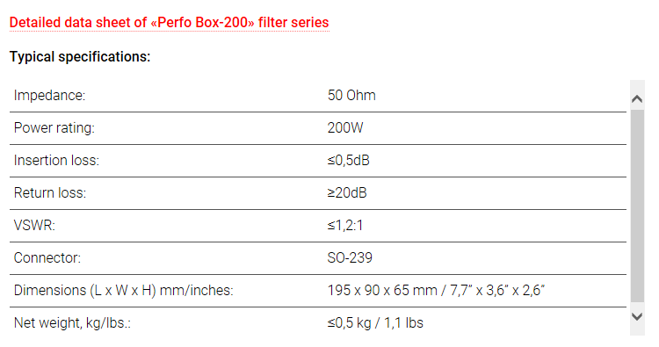
http://lowbandsystems.com/

Slide 7
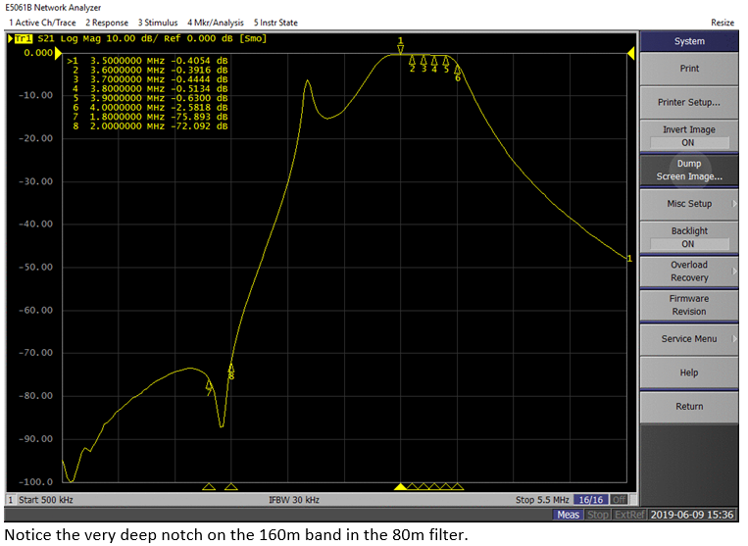

Slide 8
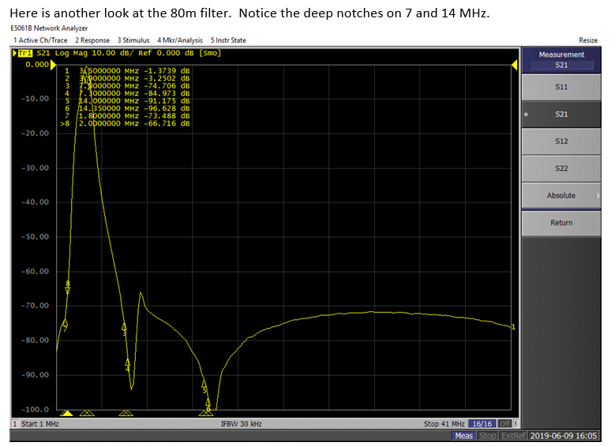

Slide 9
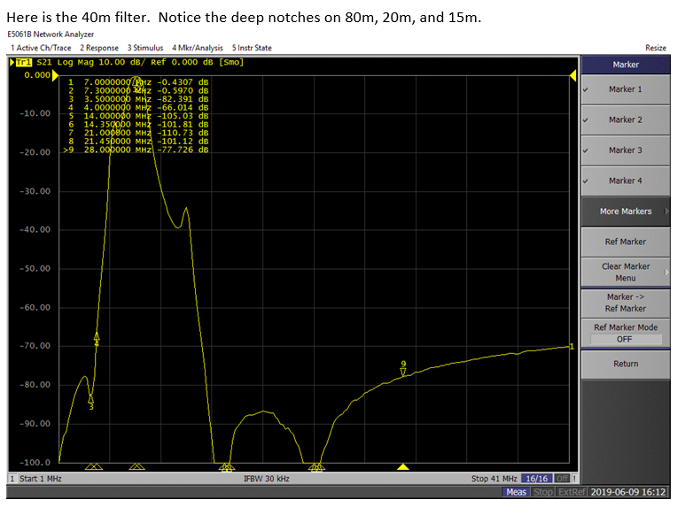

Slide 10
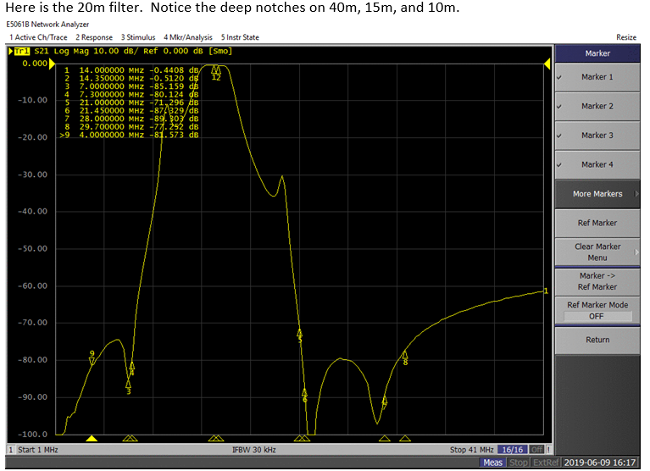

Slide 11
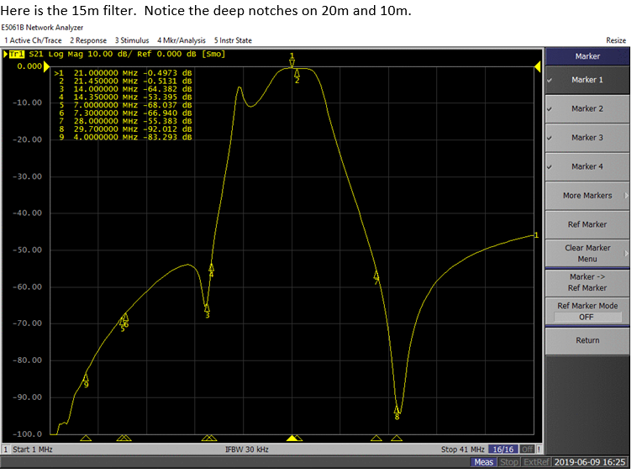

Slide 12
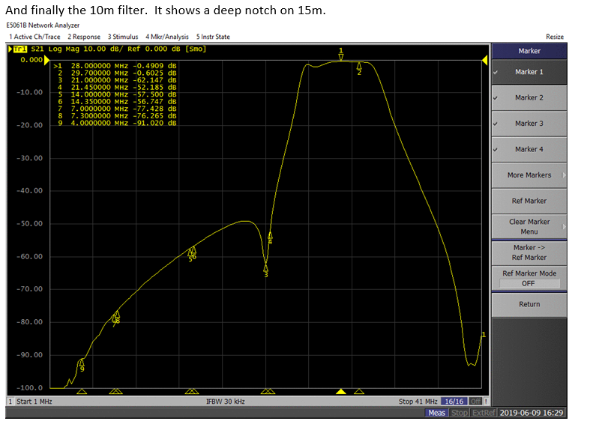

Slide 13
